Slide 1


B2B Warehouse and ETL
Arun Kumar Basnet

Slide 2
Agenda
Requirement
Data Model
ETL Architecture
ETL Framework
Demo
Presentation Title

Slide 3
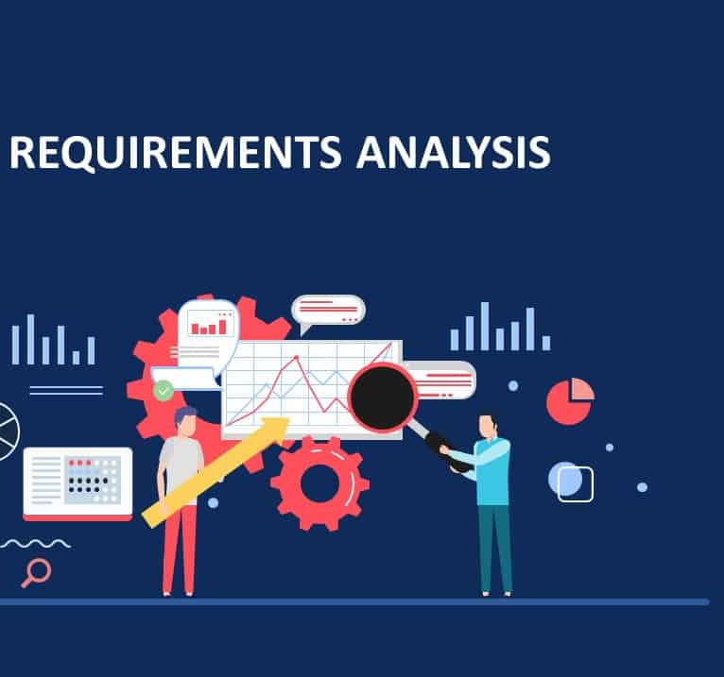
Requirement
Database implementation with generated data for the B2B database source.
Weblog generated via any script
Target DataMart
ETL process to load DataMart from Source

Slide 4
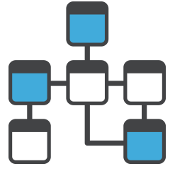
Data Model
Source Data Model
Target Data Model
PRODUCT
CUSTOMER
COMPANY
PRICE
ORDERS
SRC_BATCH_LOG
SRC_SCRIPTS_CONFIG
DWH_PRODUCT_D
DWH_CUSTOMER_D
DWH_COMPANY_D
DWH_PRICE_F
DWH_ORDERS_F
DWH_WEB_LOG_DATA
DWH_TIME_DAY_D
DWH_BATCH_LOG
DWH_SCRIPTS_CONFIG

Slide 5
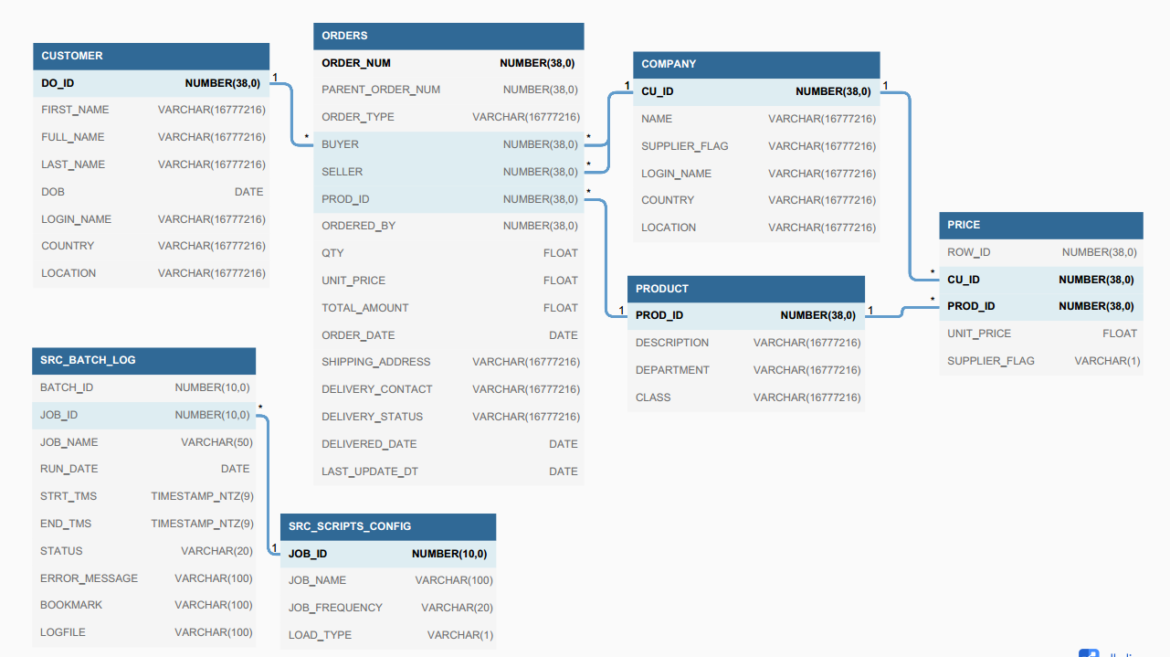
Source Data Model

Slide 6
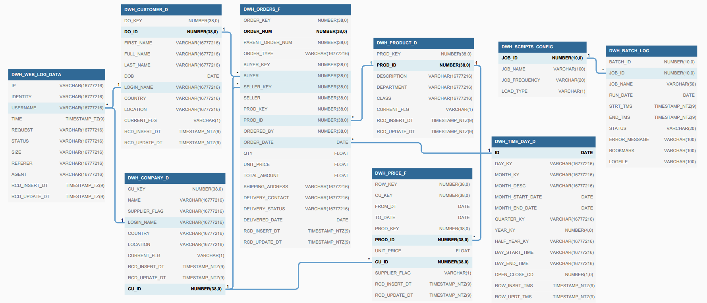
Target Data Model

Slide 7
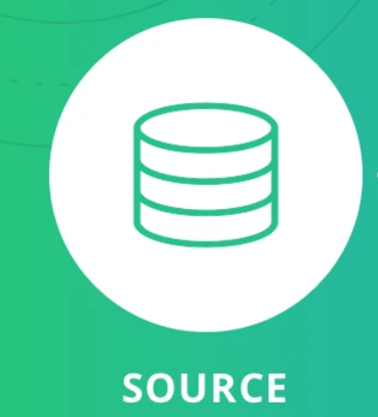
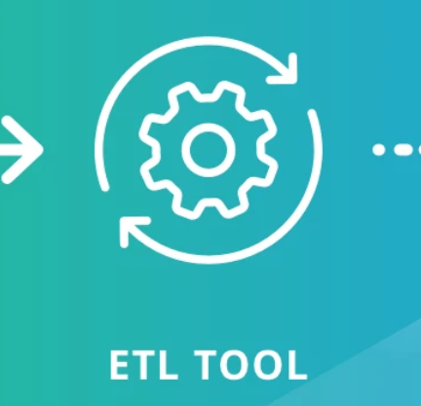
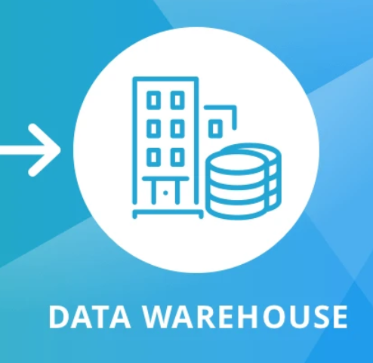
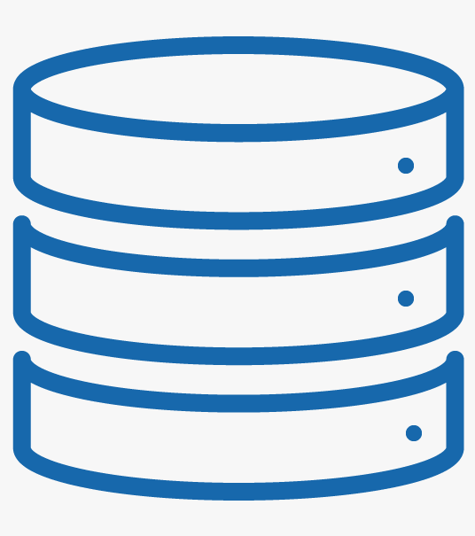






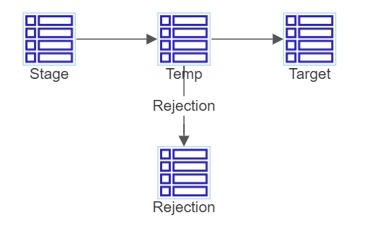
ETL Architecture
Source System
ETL SERVER
DataMart
LOAD
EXTRACTION
B2B Web Database
File Server
Data Mart
Reports
Web Log File
B2B Warehouse and ETL

Slide 8
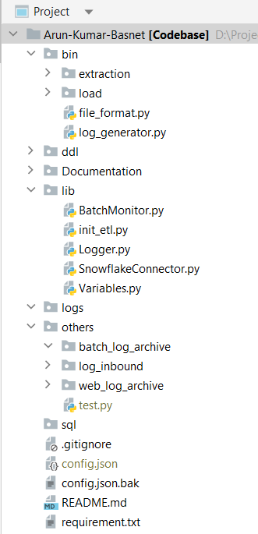
ETL Framework
bin: Directory for load and extraction python scripts.
\extraction: Contains all the extraction scripts
\load: Contains all the load scripts
ddl: Directory for the DDL used for Database objects.
Documentation: Directory for the project documents i.e Power Point for Project Demo and Technical Design Document.
lib: Library Directory for the ETL framework. It contains the scripts for all the framework modules. (which will be discussed later)
logs: Directory for the batch log for latest run.
others: Directory to load all the log file except for the current batch execution log
Batch_log_archive: Directory to store logs from previous batch executions.
log_inbound: Inbound directory of the weblog file for the batch
Web_log_archive: Directory for the past log files processed by batch
sql: Contains the sql files used to perform initial seed on the various tables and setup the Database.
config.json: file with all the credentials and environment/project variables.
config.file.bak: backup/template of config.json file
requirement.txt: Project Requirement file
B2B Warehouse and ETL

Slide 9
DEMO
B2B Warehouse and ETL

Slide 10
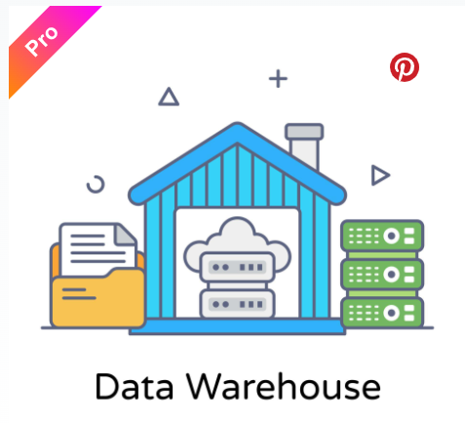
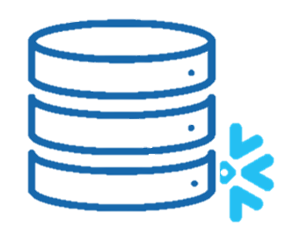

Thank you
Arun Kumar Basnet
arunkr.basnet@gmail.com

